Slide 1
Integrating Microsoft PlayFab Services into Vanguard-Outrider Demo Game for Enhanced Player Experience
Dev_Team_2
Aravind Vudatha
Lakshmi Priya Mutyala
Vamshi gone
Gopi Mandapati

Slide 2
Microsoft PlayFab
Microsoft PlayFab is a cloud-based backend platform for game developers that provides services and tools to build, launch, and grow online games. It was founded in 2014 and acquired by Microsoft in 2018. PlayFab offers features such as player authentication, data storage, matchmaking, leaderboards, messaging, content management, and analytics. It supports authentication and authorization, data management, multiplayer, monetization, live ops, and analytics. PlayFab is a powerful platform that helps developers build, launch, and grow their games by providing a suite of tools and services that are user-friendly and flexible.

Slide 3
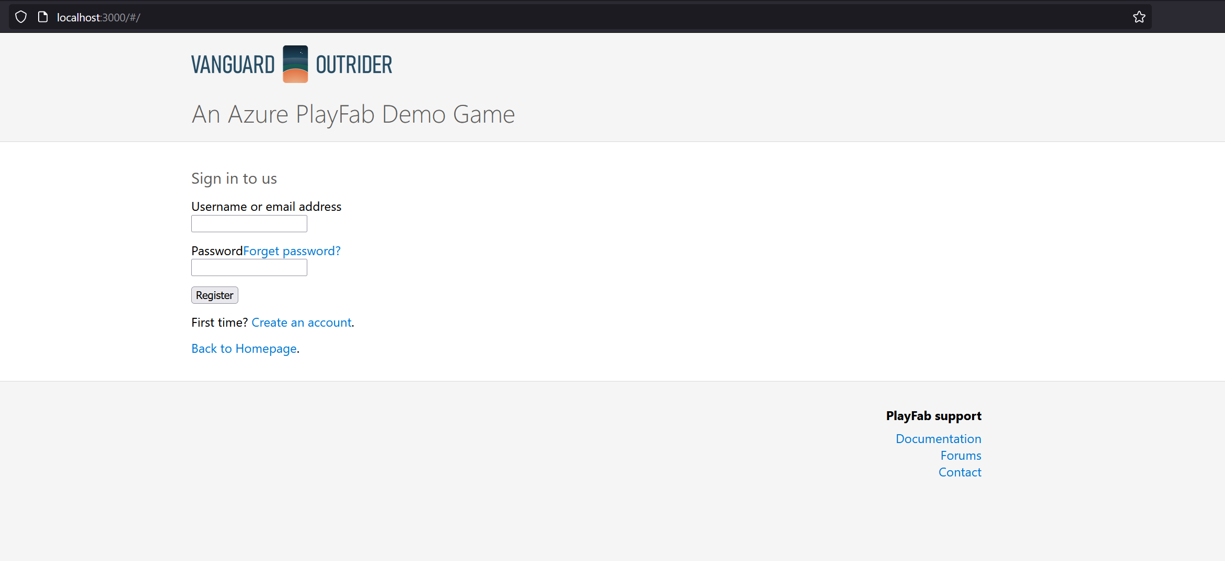
REGISTER PAGE

Slide 4
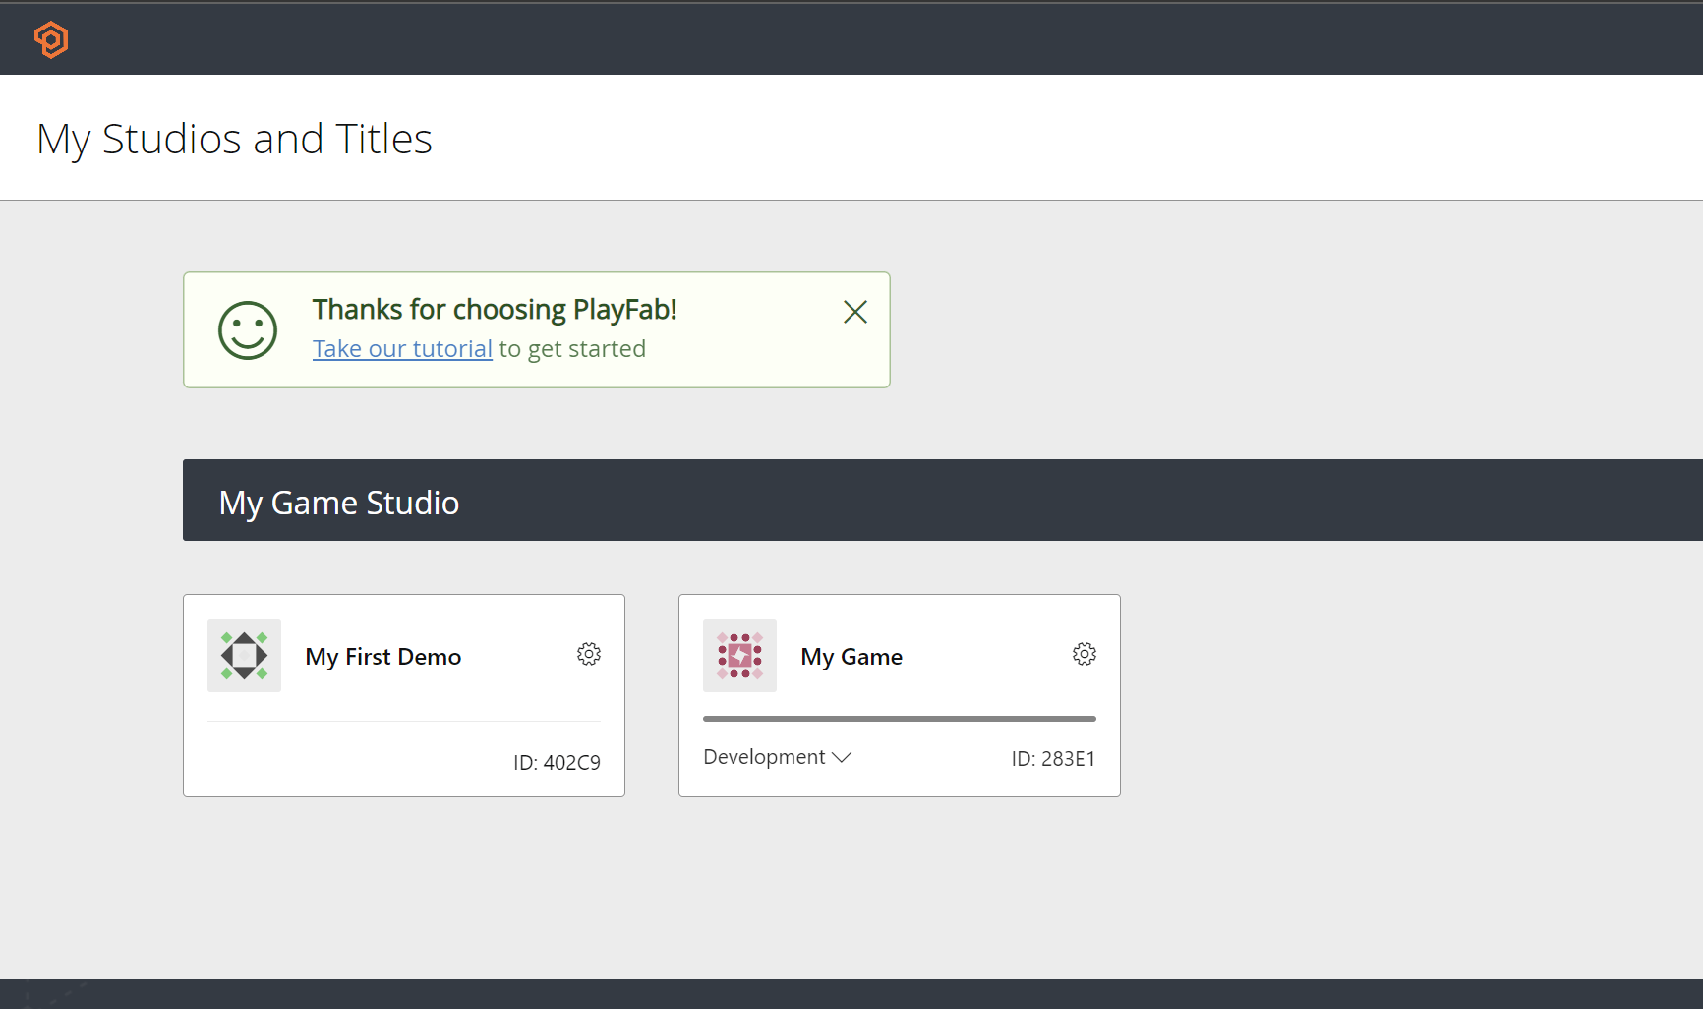
Available Games:

Slide 5
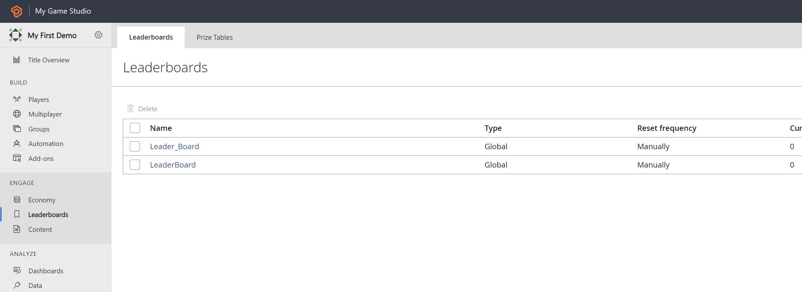
Leaderboard:

Slide 6
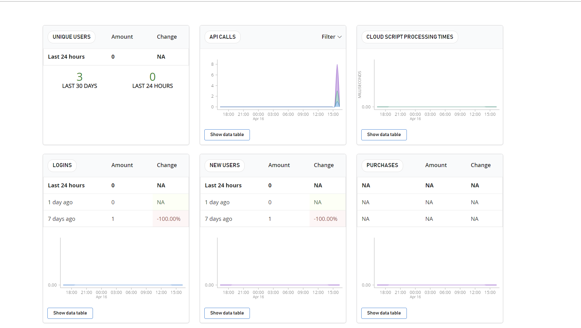
Statistics:

Slide 7
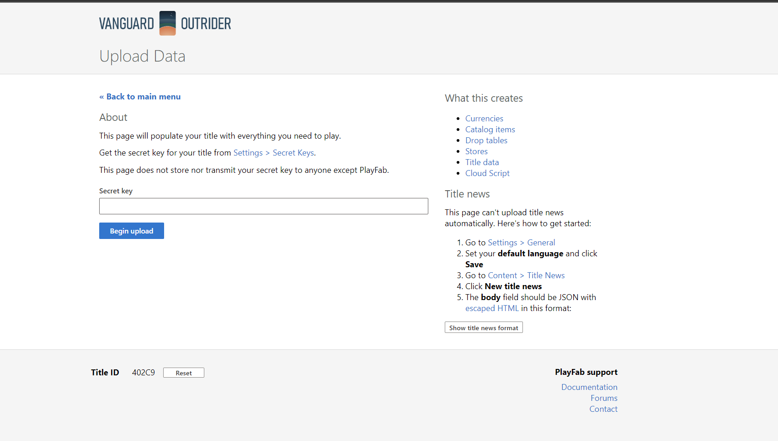

Slide 8
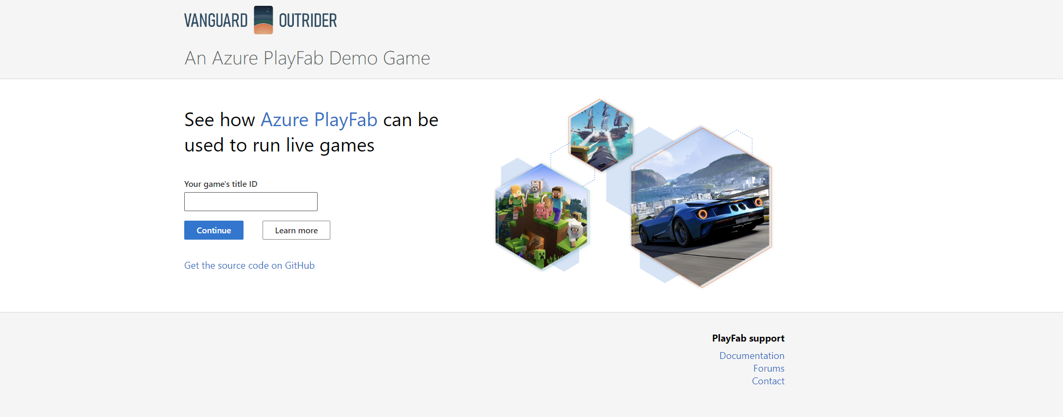
Enter Game Title:

Slide 9
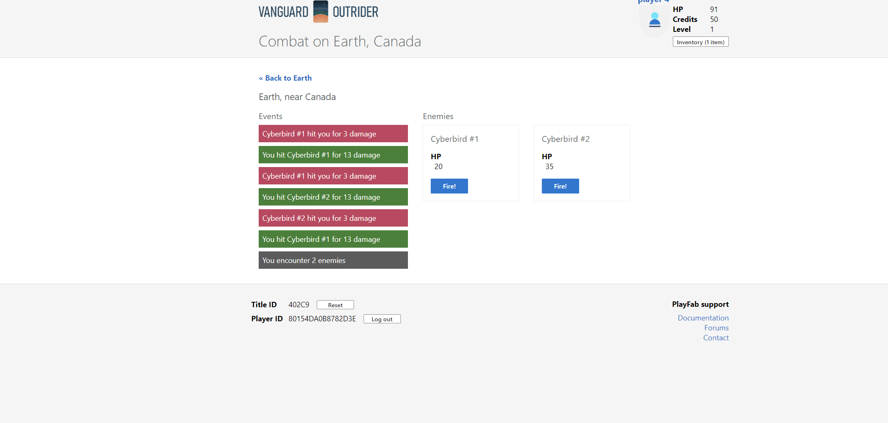
Game Play:

Slide 10
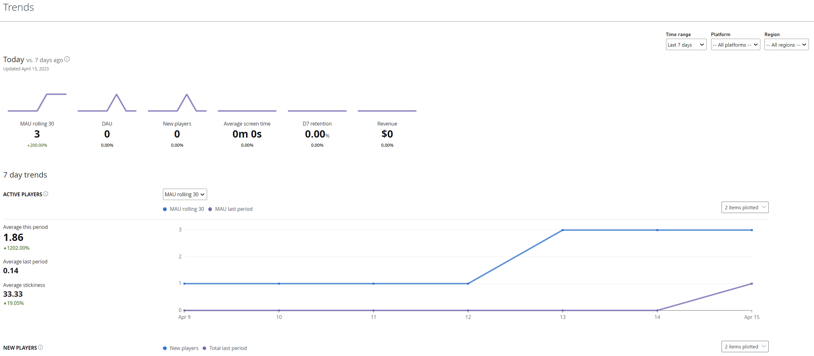
Stats:

Slide 11
Challenges Faced:
When attempting to run the code for the Vanguard-Outrider demo game in a local server, an error was encountered due to a version mismatch of Babel in React. This meant that the code was not able to compile or run correctly, which prevented the game from functioning properly.
Solution: To overcome this issue, we added an environment variable to an .env file in the project directory with the following line of code:
SKIP_PREFLIGHT_CHECK=true
This environment variable instructs React to skip the preflight check during the build process, which can resolve version mismatches and other issues related to dependencies. By adding this line of code to the .env file, we were able to bypass the version mismatch of Babel and successfully compile and run the code for the Vanguard-Outrider demo game in the local server.
In summary, the problem faced was a version mismatch of Babel in React, which was resolved by adding an environment variable to the .env file with the SKIP_PREFLIGHT_CHECK=true command. This allowed us to overcome the issue and continue with the integration of PlayFab services into the Vanguard-Outrider demo game.

Slide 12
Thank you

